Slide 1

Python based Dicom Images Visualizer

Slide 2
HELLO!
I am Pablo
You can find me at pablo.giaccaglia@mail.polimi.it

Slide 3
1.
WHAT IS DicomViz ?
Let’s start with a general overview

Slide 4
DICOMViz, a modular, expandable and lightweight portable
DICOM viewer.

Slide 5
FEATURES
Let’s see together some of
the DicomViz capabilities.

Slide 6
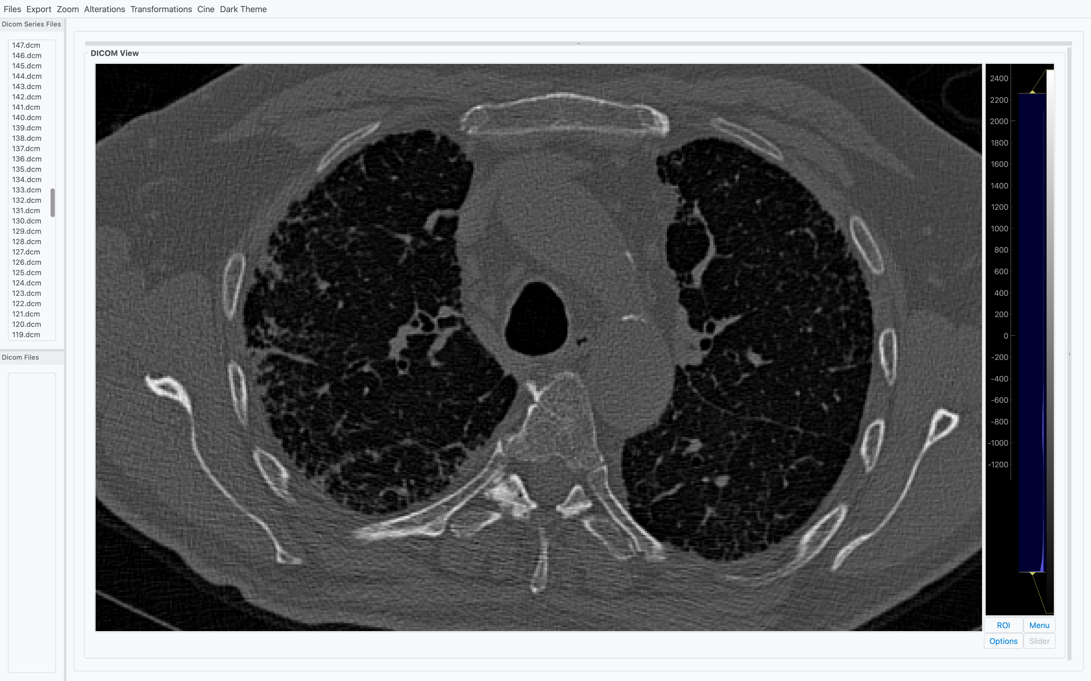
IMAGE VISUALIZATION
Support for:
Dicom files
Dicom series

Slide 7
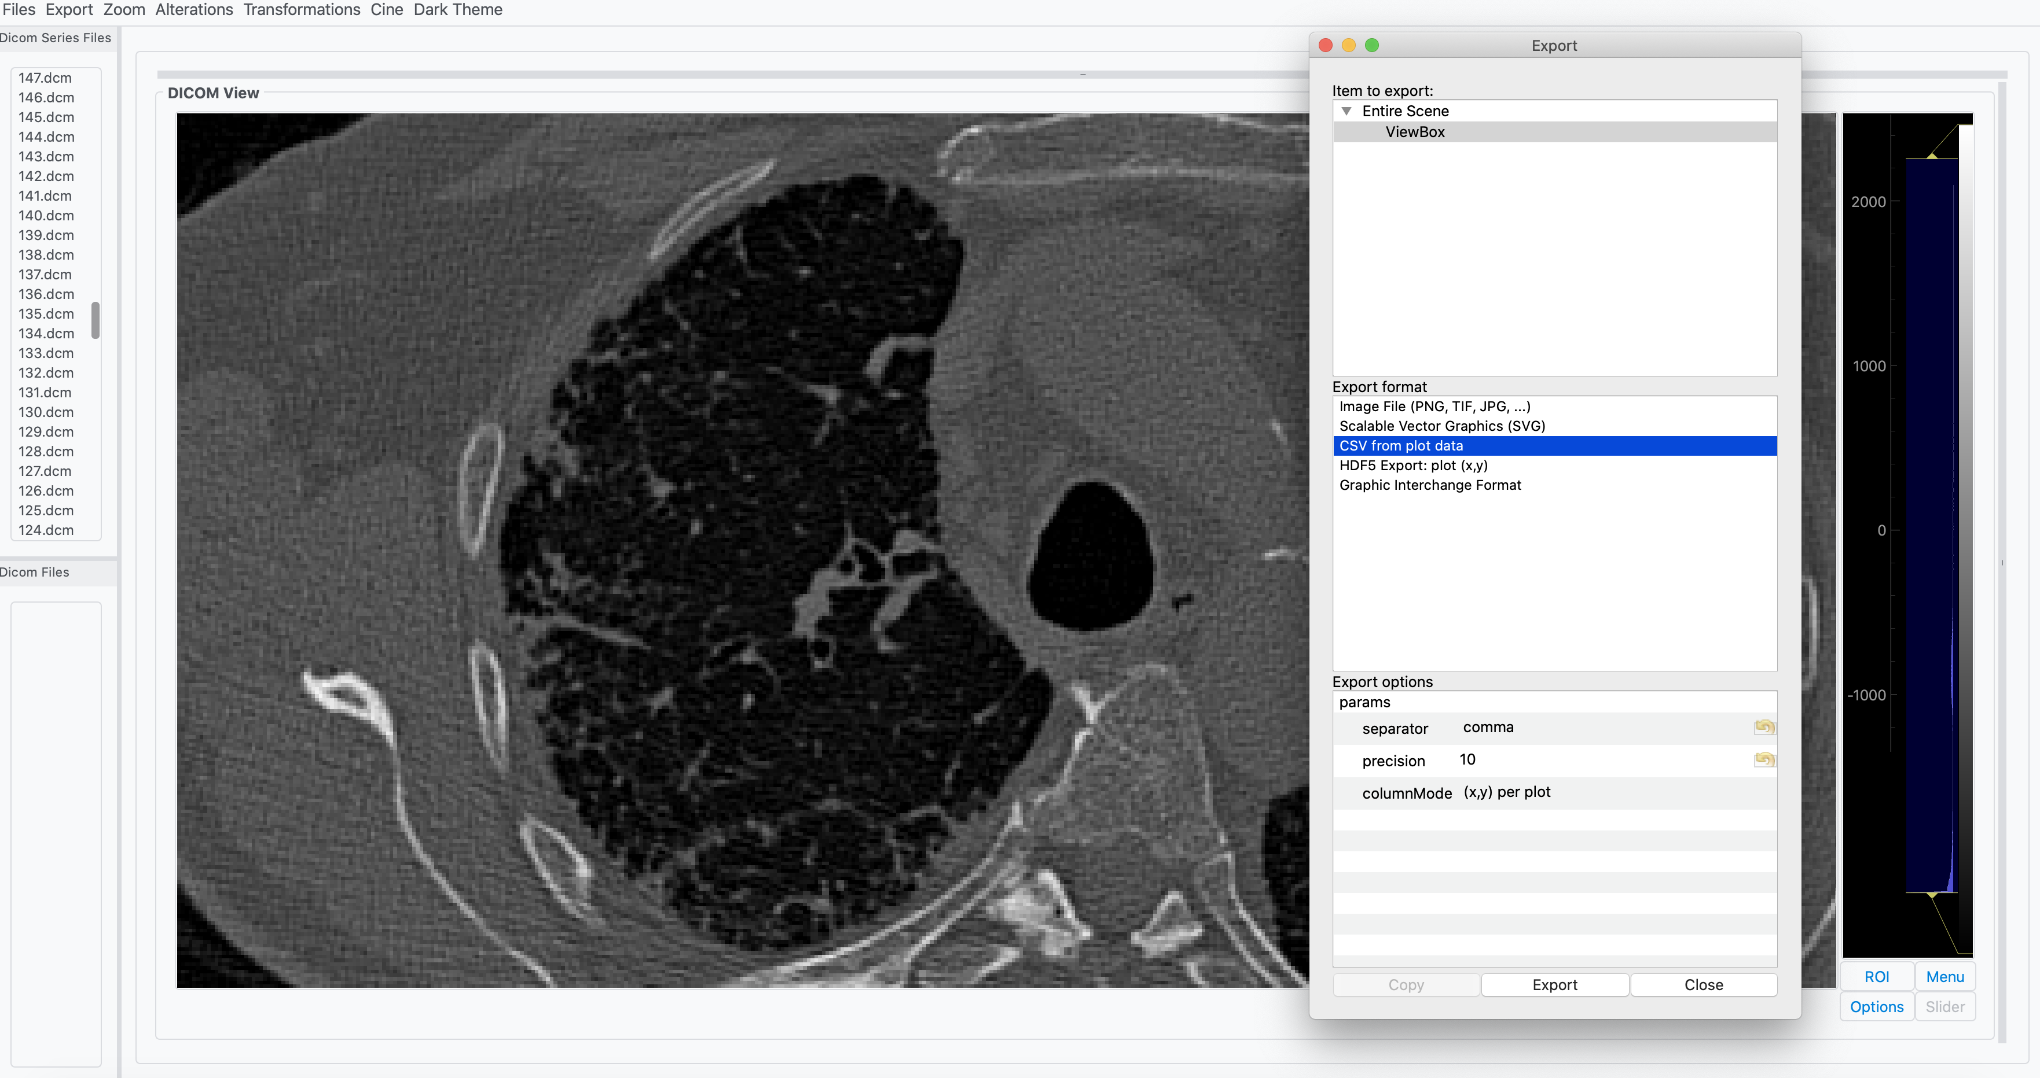
EXPORT
Export to:
PNG file
JPEG file
TIFF file
SVG file
GIF of series
more…

Slide 8
GIF EXPORT
Series images can be exported as gifs.
Export of altered images is supported.

Slide 9
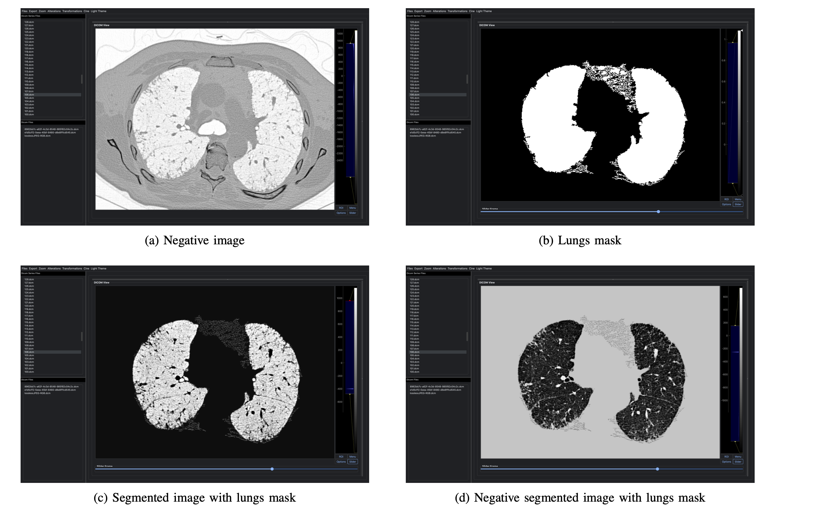
Several combinations available.
ALTER DICOMS

Slide 10
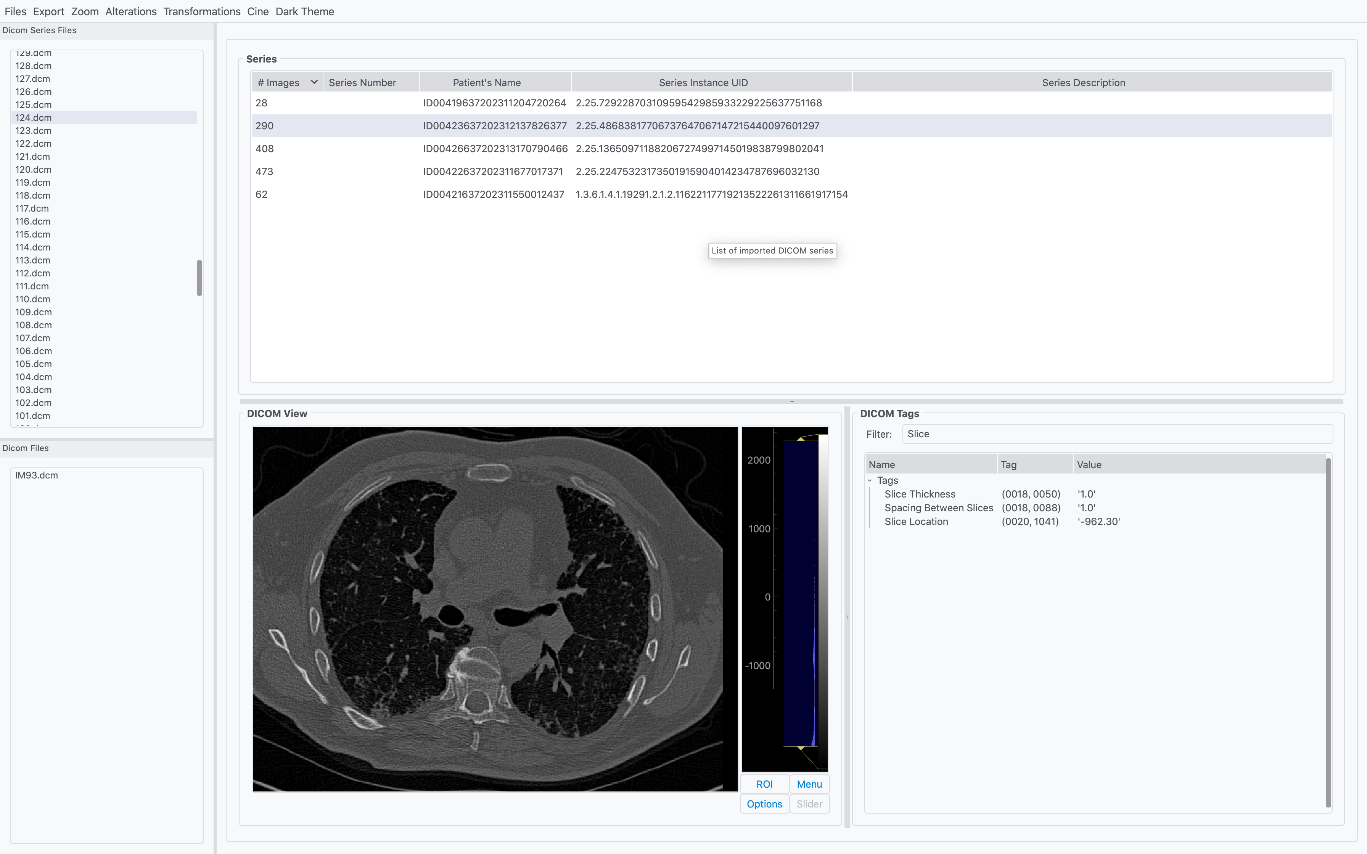
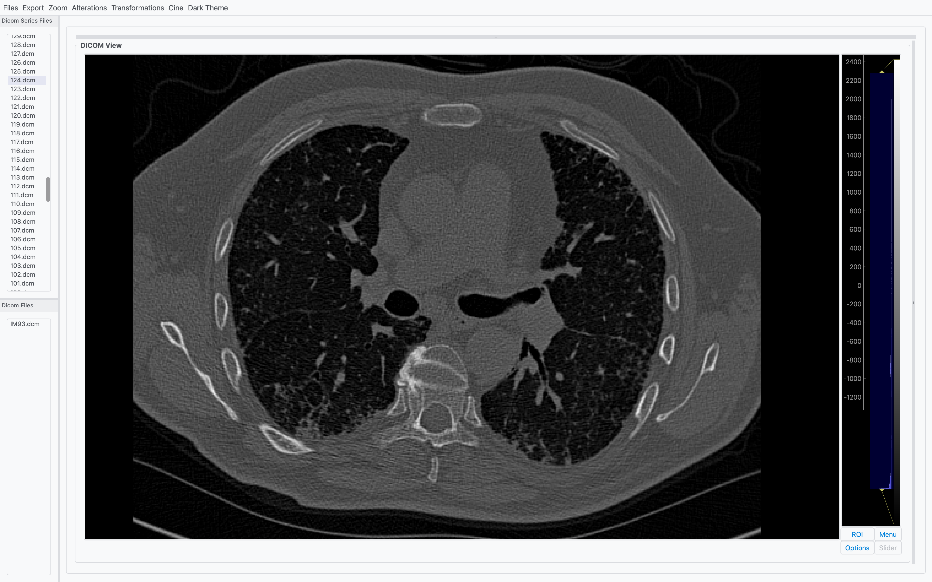
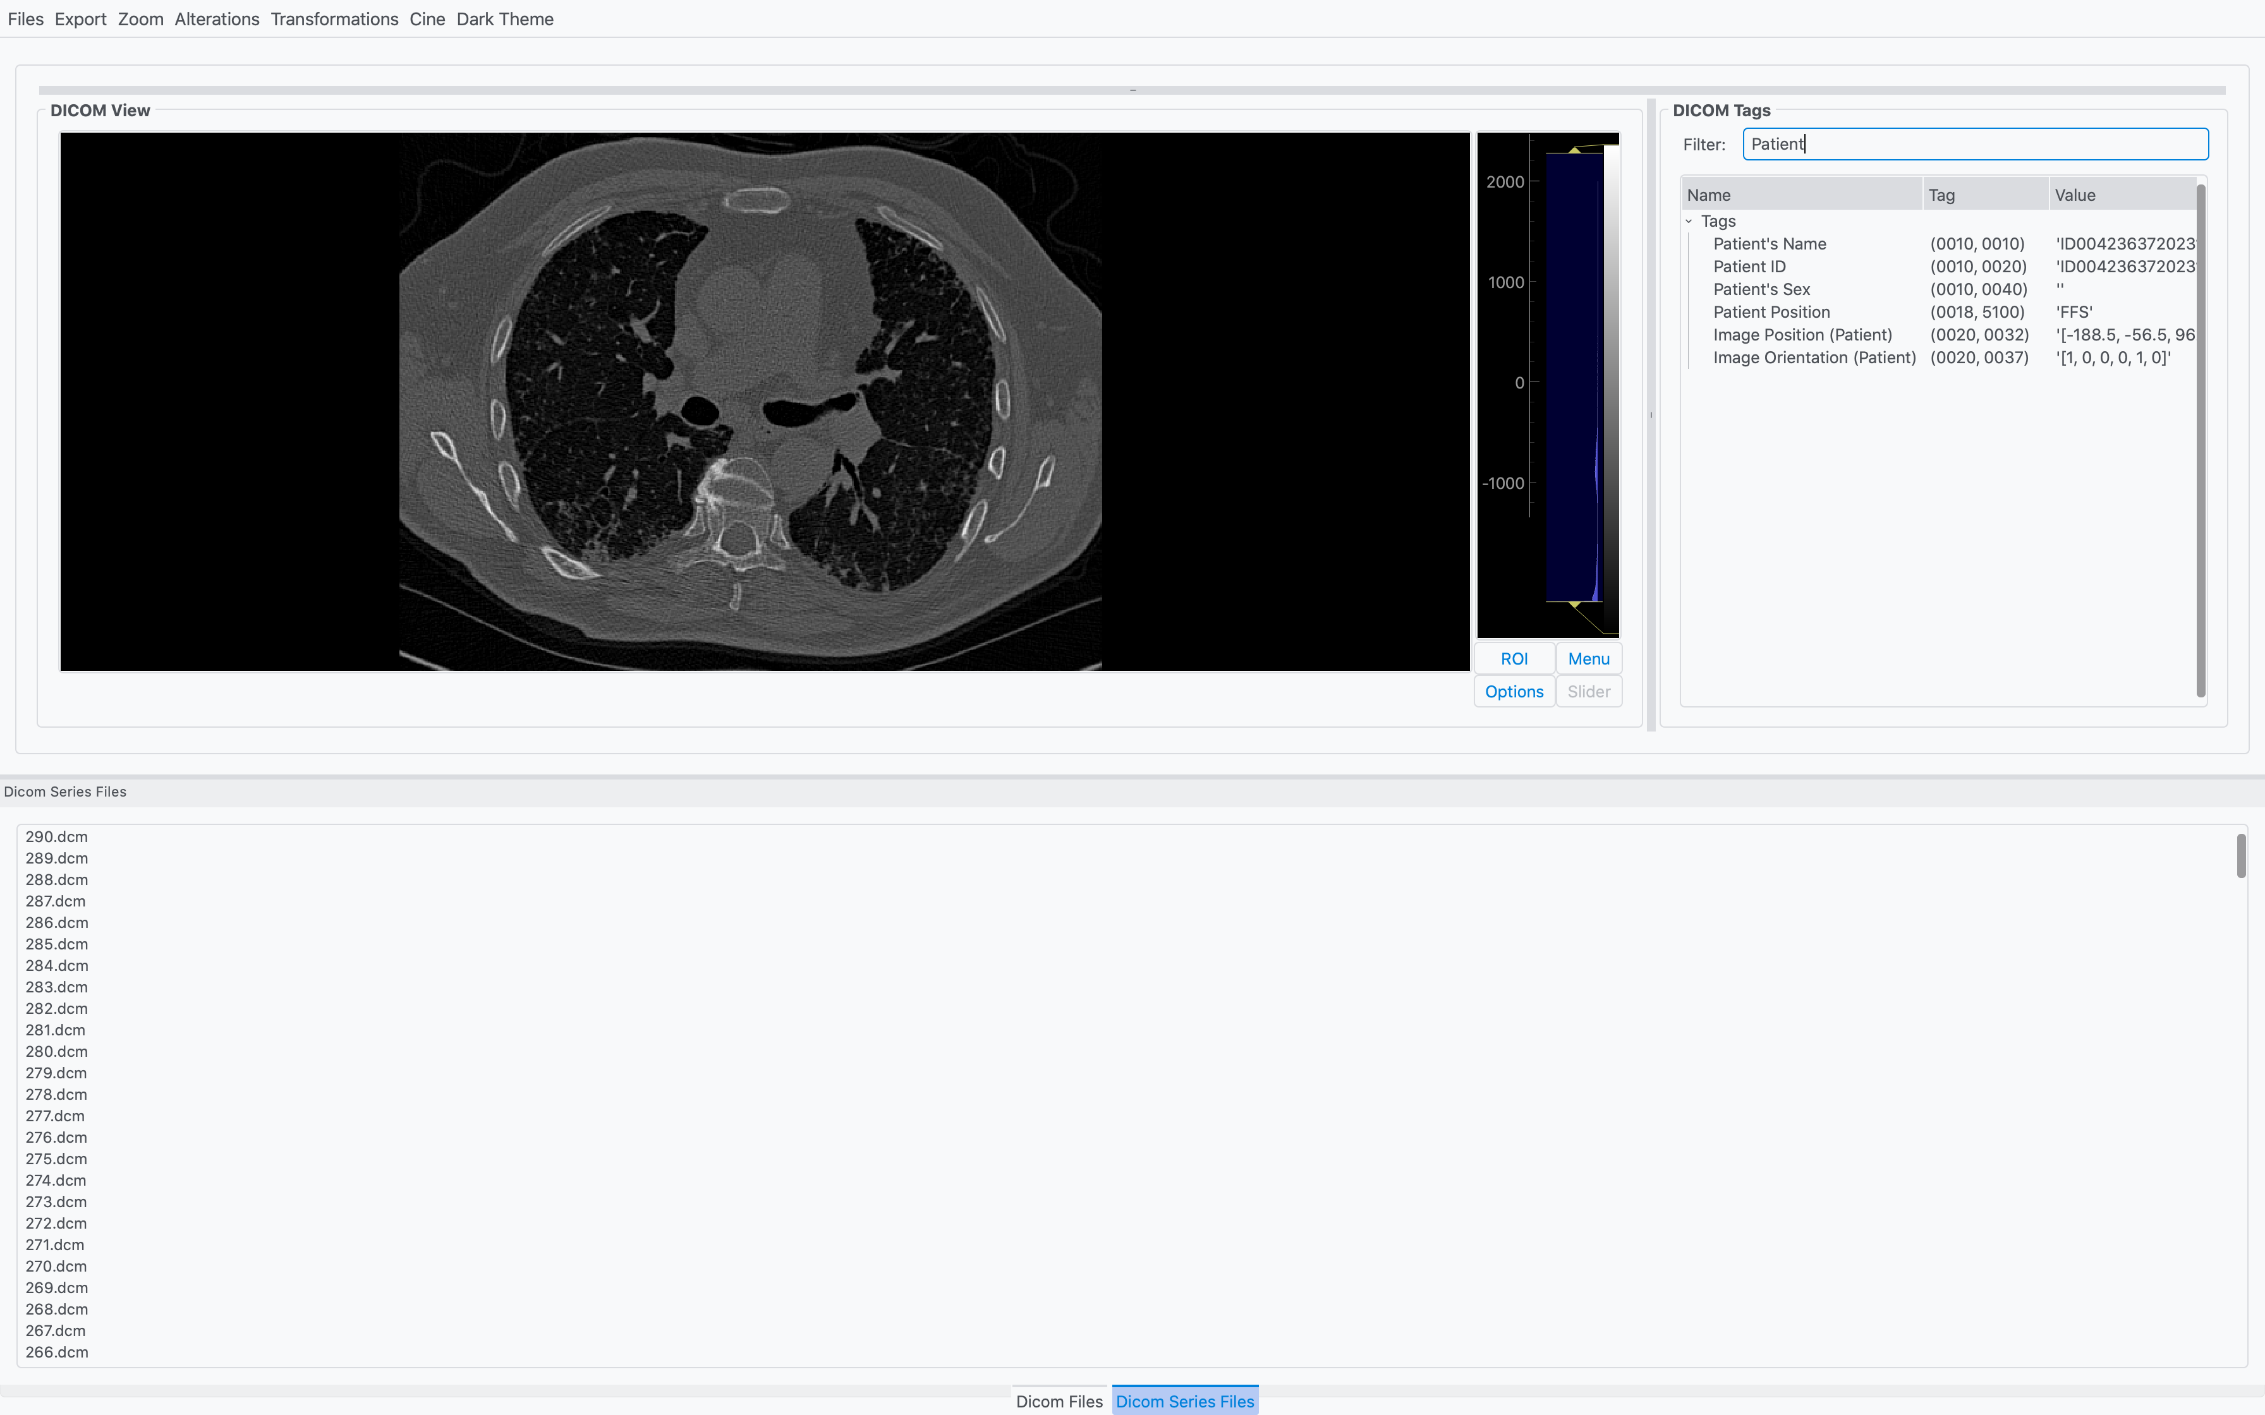
Focus on your needs.
CUSTOMIZE
LAYOUT

Slide 11
To get your stuff done.
Change background color
Change color map
MORE
FUNCTIONALITIES
Rotate and flip images
Remove loaded files

Slide 12
2.
How it has been done?
Let’s deep into technical part

Slide 13




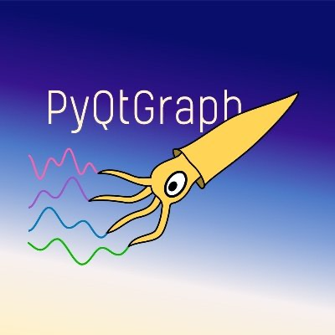
DicomViz building blocks are popular and updated libraries.
PyDicom
NumPy
Qt Designer
PyQt
ALL TIME CLASSICS
PyQtGraph

Slide 14
Pure Python package for working with DICOM files. Read, write, modify DICOM data.
PyDicom
NumPy
Qt Designer
PyDicom
PyQt
PyQtGraph

Slide 15
Fundamental package for scientific computing, used to manipulate Dicom data arrays.
PyDicom
NumPy
Qt Designer
NumPy
PyQt
PyQtGraph

Slide 16
Tool for designing and building GUIs with Qt Widgets.
PyDicom
NumPy
Qt Designer
Qt Designer
PyQt
PyQtGraph

Slide 17
Python binding for the Qt framework. The core element of DicomViz GUI
PyDicom
NumPy
Qt Designer
PyQt
PyQt
PyQtGraph

Slide 18
Graphics and GUI library built on PyQt and Numpy. Core element for viewing images in DicomViz
PyDicom
NumPy
Qt Designer
PyQtGraph
PyQt
PyQtGraph

Slide 19
DICOMViz, a modular, expandable and lightweight portable
DICOM viewer.

Slide 20
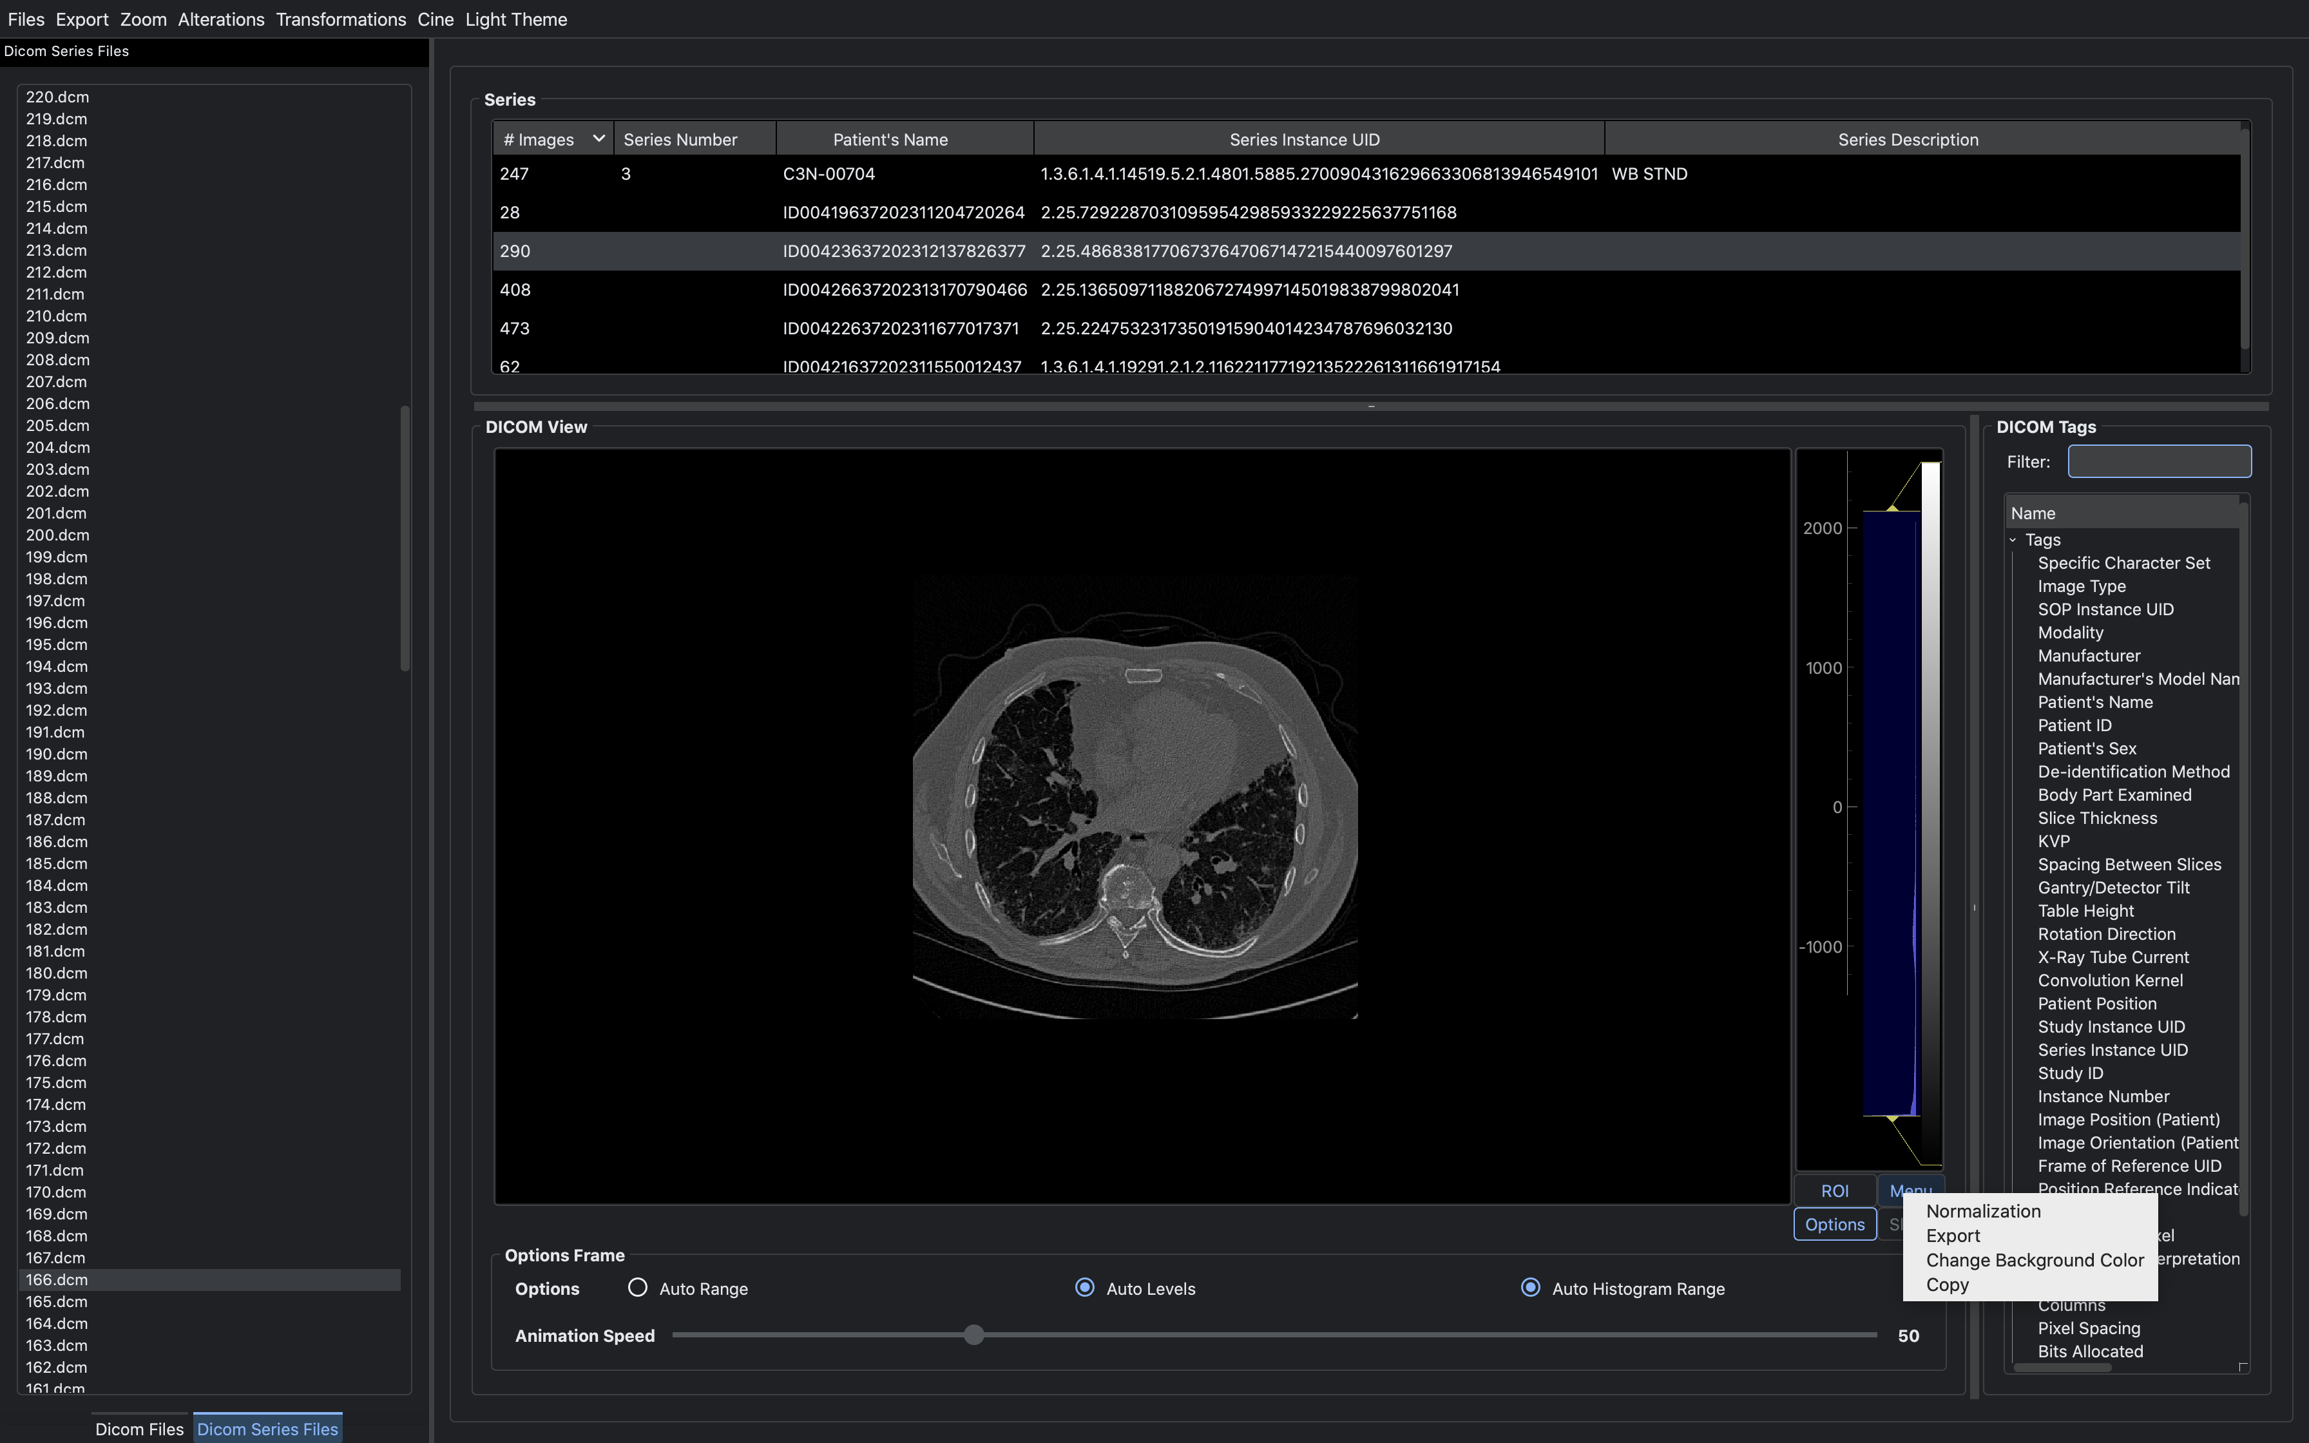
DICOMViz, a modular, expandable and lightweight portable
DICOM viewer.

Slide 21
DICOMViz, a modular, expandable and lightweight portable
DICOM viewer.

Slide 22
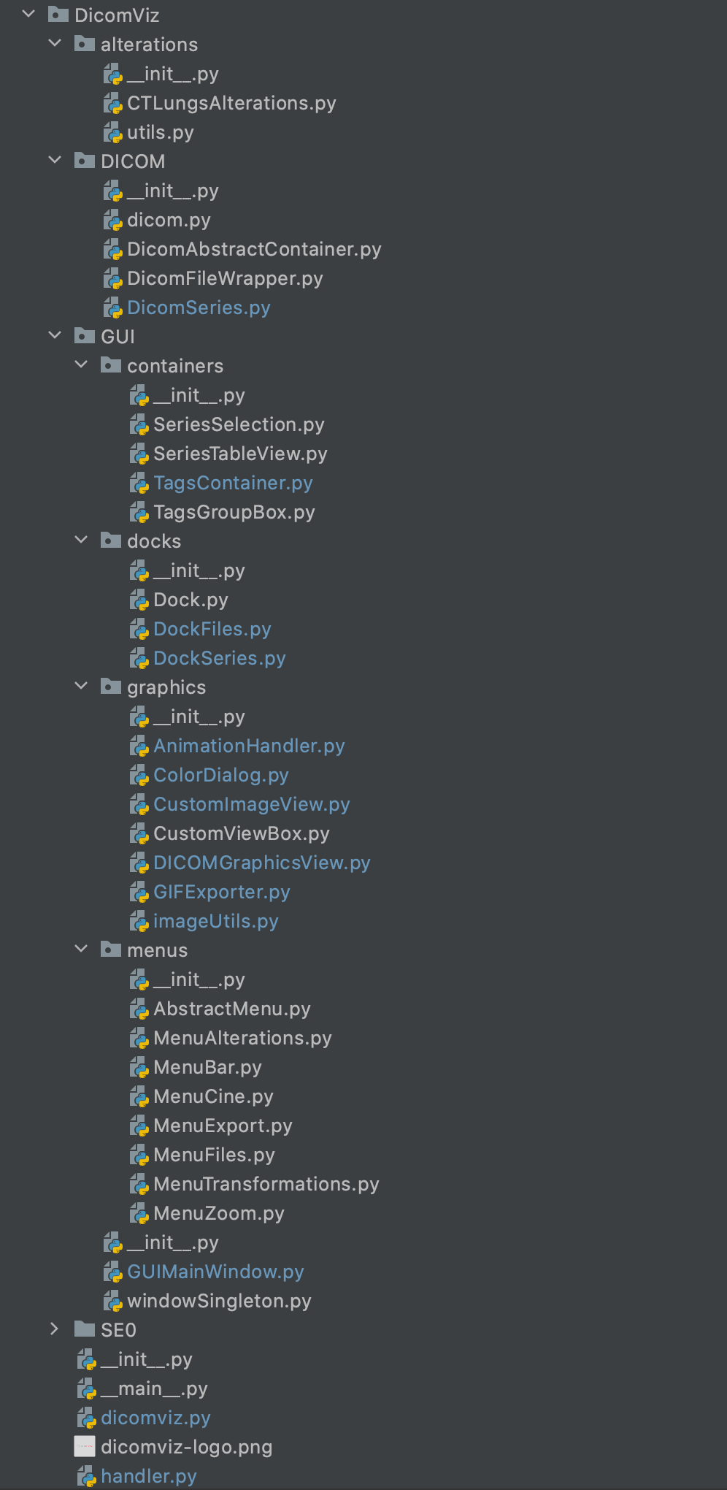
Following object oriented principles.
Project modules
MODULARITY

Slide 23
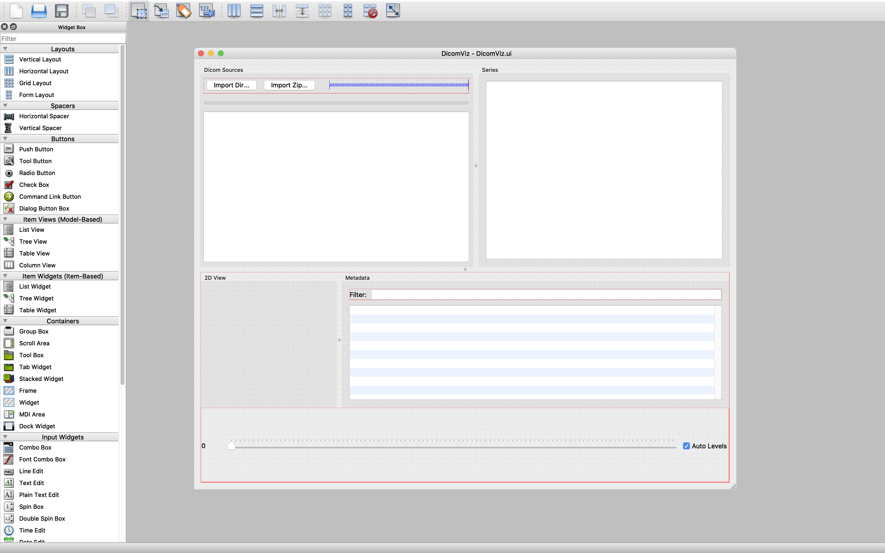
Following object oriented principles.
EXPANDABILITY
Many QtWidgets available

Slide 24
THANKS!
Pablo Giaccaglia

